Slide 1

50.039 Theory and Practice of Deep Learning W10-S1 Generative Models in Deep Learning
Matthieu De Mari

Slide 2
What we have done so far
All our models so far had something in common:
The dimensionality of the inputs was always superior to the dimensionality of the outputs.
E.g. Receiving Tabular data, images, time series, words graphs as inputs and predicting a single value (regression) or a given class in a finite number of classes (much smaller).
Only Seq2Seq models and SkipGram models somehow broke this idea. (But SkipGram was not doing so great anyway).

Slide 3
What we have done so far
All our models so far had something in common:
The dimensionality of the inputs was always superior to the dimensionality of the outputs.
Question:
→ Does that mean it is impossible for Deep Learning models to have a higher dimensionality for outputs?

Slide 4
About this week (Week 10)
What are typical generative models in deep learning?
What is an autoencoder and what are its uses?
What is a fractionally strided convolution layer?
What are variational autoencoders and why do noise representations of latent features work better than the ones in standard autoencoders?
What are Generative Adversarial Networks (GANs) and their uses?
What are the advanced techniques in GANs and deepfakes?

Slide 5
Outline
In this lecture
Autoencoders definition
Autoencoders with fully connected layers
Fractionally strided convolution layers
Autoencoders with convolutions and deconvolutions
Autoencoder uses
In the next lectures
Variational Autoencoder and noisy latent representations
Generative Adversarial Networks
More advanced GANs

Slide 6
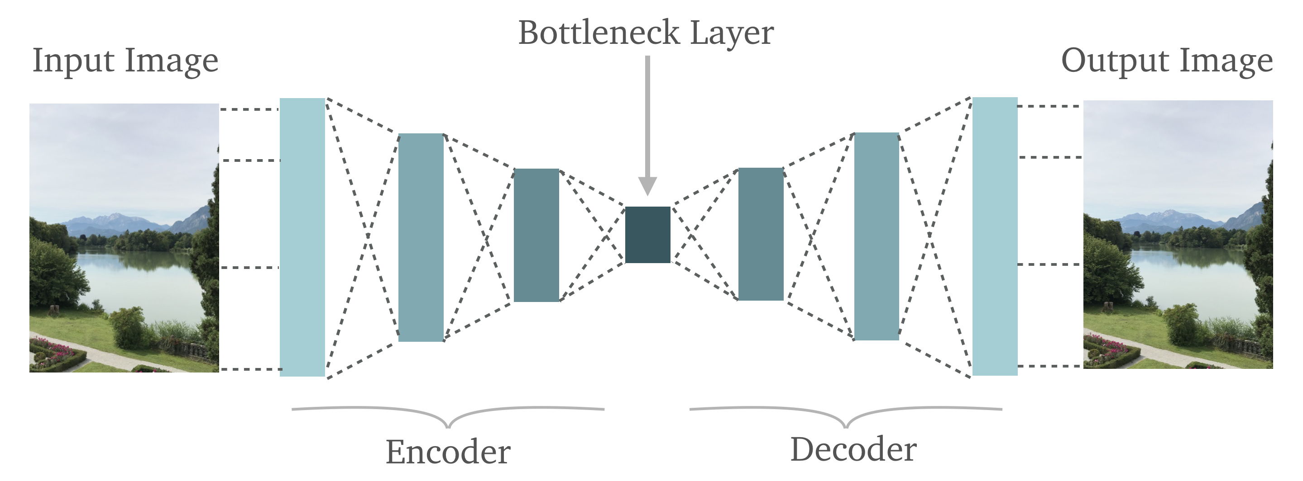
AutoEncoders: a definition
Definition (AutoEncoder):
An AutoEncoder is a neural network that learns to copy its input to its output. Basically, it attempts to approximate the identity function.

Slide 7
AutoEncoders: a definition

Slide 8
AutoEncoders: a definition
Definition (AutoEncoder):
An AutoEncoder is a neural network that learns to copy its input to its output. Basically, it attempts to approximate the identity function.
It has an internal (hidden) layer that describes a code used to represent the input, and is called the feature representation or latent representation of the input.

Slide 9
AutoEncoders: a definition
Definition (AutoEncoder):
An AutoEncoder is a neural network that learns to copy its input to its output.
It is constituted of two main parts:
an encoder that maps the input into the code,
and a decoder that maps the code to a reconstruction of the input.

Slide 10
AutoEncoders: a definition
Definition (AutoEncoder):
Autoencoders are usually restricted in their latent representation dimensionality.
This forces them to reconstruct the input approximately, preserving only the most relevant aspects of the data in the copy.

Slide 11
AutoEncoders: a definition
Definition (AutoEncoder):
AutoEncoders are (un)supervised artificial neural networks, which
learn how to efficiently compress and encode data,
and then learns how to reconstruct the data back from the reduced encoded representation to a representation that is as close to the original input as possible.

Slide 12
AutoEncoders structure
Autoencoders consists of 4 main parts, to be discussed in the next few slides:
Encoder
Bottleneck
Decoder
Reconstruction Loss

Slide 13
AutoEncoders structure
Encoder: In which the model learns how to reduce the input dimensions and compress the input data into an encoded representation. An encoder will, for instance, consist of successive fully connected layers, decreasing in size.

Slide 14
AutoEncoders structure
Bottleneck: which is the layer that contains the compressed representation of the input data. Technically, we want the dimensionality to be the lowest possible dimension of the input data (more on this later).

Slide 15
AutoEncoders structure
Decoder: In which the model learns how to reconstruct the data from the encoded representation to be as close to the original input as possible. Our decoder will, for instance, consist of successive fully connected layers, increasing in size, back to the original input size.

Slide 16
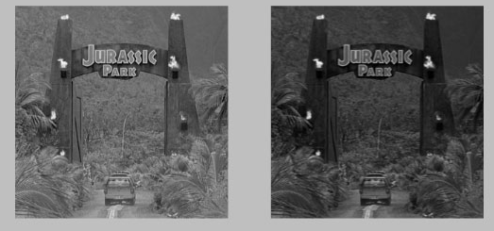
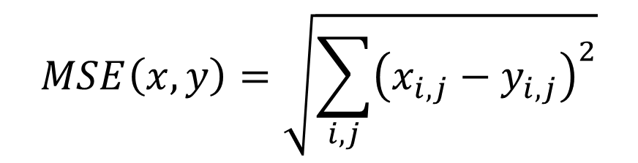
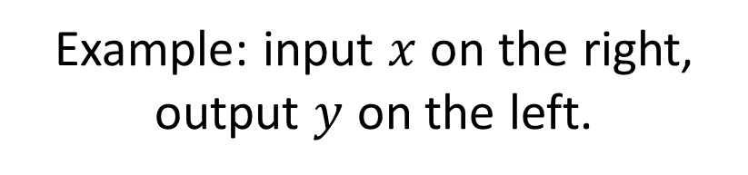
AutoEncoders structure
Reconstruction Loss: This is the method that measures measure how well the decoder is performing and how close the output is to the original input. In the case of images, we can typically use an MSE on all pixels, or variations of it.
Example: input $x$ on the right, output $y$ on the left.
$$MSE\left(x,y\right)=\sqrt{\sum_{i,j}{{\left(x_{i,j}−y_{i,j}\right)}^{2}}}$$

Slide 17
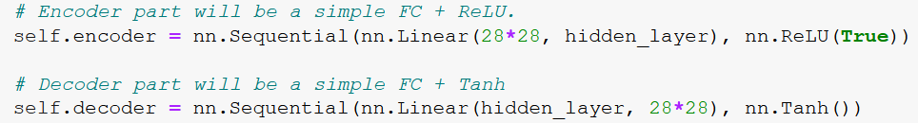
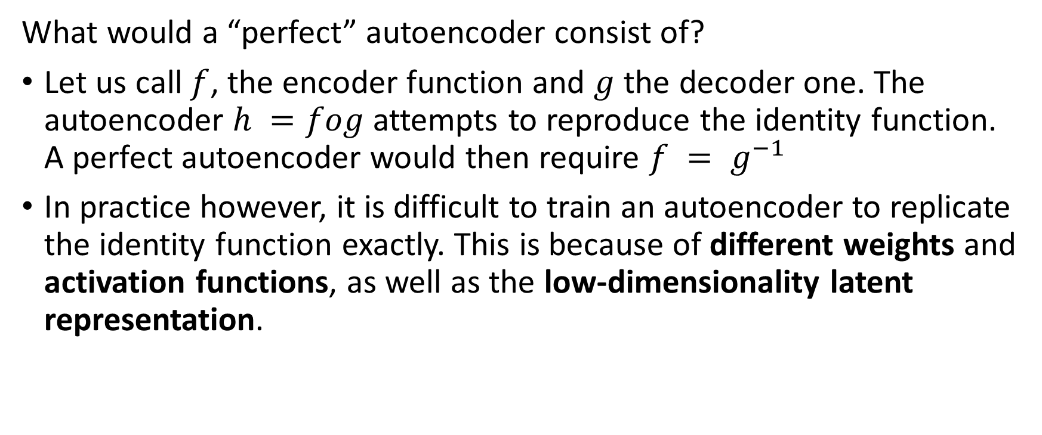
On reversibility of layers
What would a “perfect” autoencoder consist of?
Let us call $f$, the encoder function and $g$ the decoder one. The autoencoder $h =fog$ attempts to reproduce the identity function. A perfect autoencoder would then require $f = g^{−1}$
In practice however, it is difficult to train an autoencoder to replicate the identity function exactly. This is because of different weights and activation functions, as well as the low-dimensionality latent representation.

Slide 18
On reversibility of layers
At best, we can simply ensure that the layers preserve dimensionality.
That is, the encoder compresses an input into a low-dimensionality latent representation in the same way that the decoder decompresses the low-dimensionality latent representation into an output of the same dimensions.
This is simply done, for instance, with fully connected layers, with mirrored sizes, in both the encoder and the decoder sides.

Slide 19
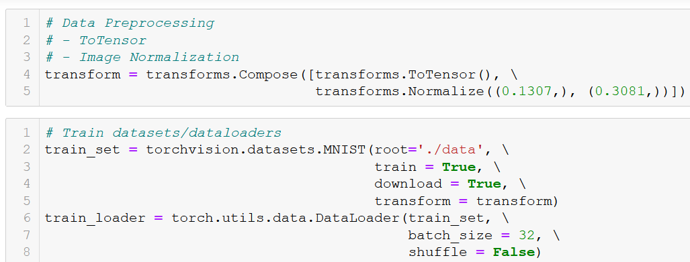
A first toy example: MNIST autoencoder with fully connected layers
Let us start with a simple autoencoder on MNIST (refer to Notebook 1. for demo code).
The dataset is simply MNIST, input dimensions are 28 by 28 pixel images, greyscale.

Slide 20
A first toy example: MNIST autoencoder with fully connected layers
Let us start with a simple autoencoder on MNIST (refer to Notebook 1. for demo code).
Our model consists of
An encoder, simply modelled as a fully connected layer from 28*28 into a hidden layer size, to be decided.
A decoder, simply modelled as a fully connected layer from the hidden layer size, back into 28*28.

Slide 21
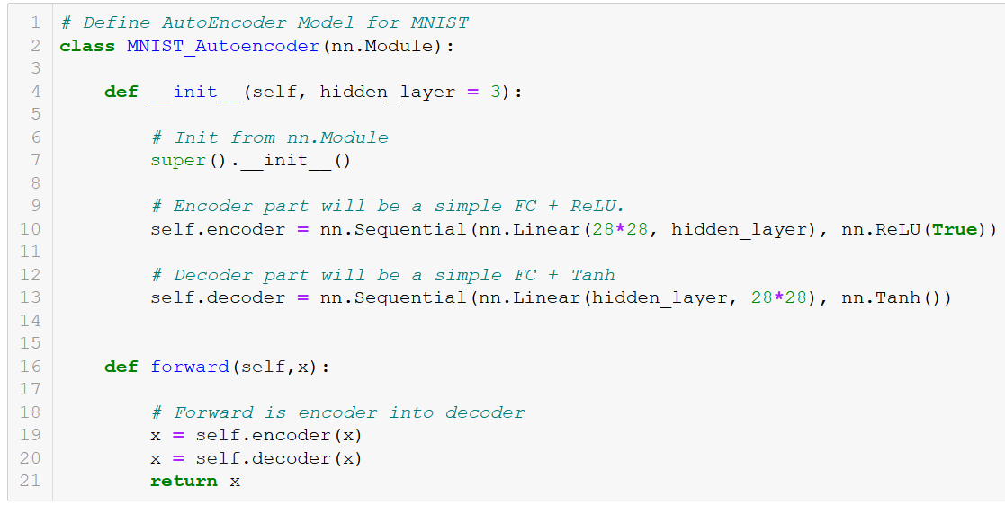
A first toy example: MNIST autoencoder with fully connected layers

Slide 22
A first toy example: MNIST autoencoder with fully connected layers
Let us start with a simple autoencoder on MNIST (refer to Notebook 1. for demo code).
Our model will be trained on the MNIST dataset, with the following parameters:
Start with hidden_size = 5, that is the dimensionality of the latent representation in the bottleneck layer.
MSE as the reconstruction loss.
Optimizer is Adam, with default parameters.
Mini-batch with size 128 and 25 epochs.

Slide 23
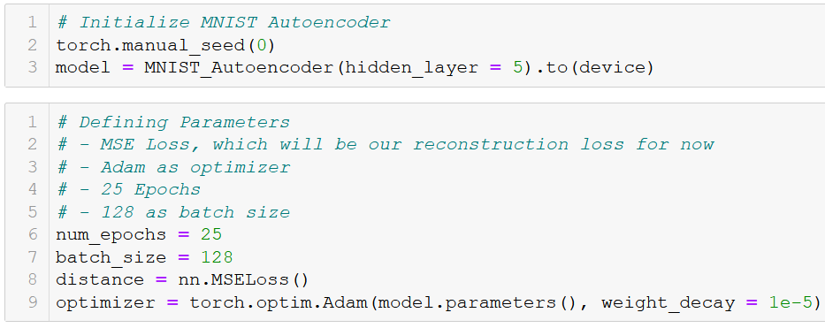
A first toy example: MNIST autoencoder with fully connected layers

Slide 24
A first toy example: MNIST autoencoder with fully connected layers
Let us start with a simple autoencoder on MNIST (refer to Notebook 1. for demo code).
Our model will be trained on the MNIST dataset, with the steps:
Flatten the image, so it can be fed into FC layers.
Forward pass.
Backward pass and backpropagation.
Loss and Outputs kept for visualization later on.

Slide 25
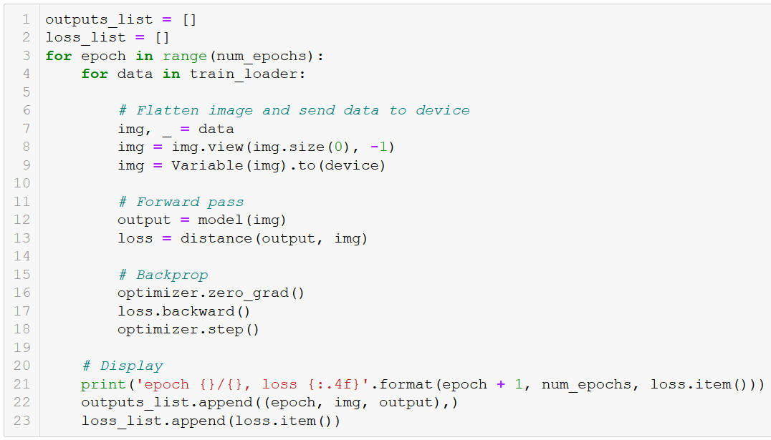
A first toy example: MNIST autoencoder with fully connected layers

Slide 26
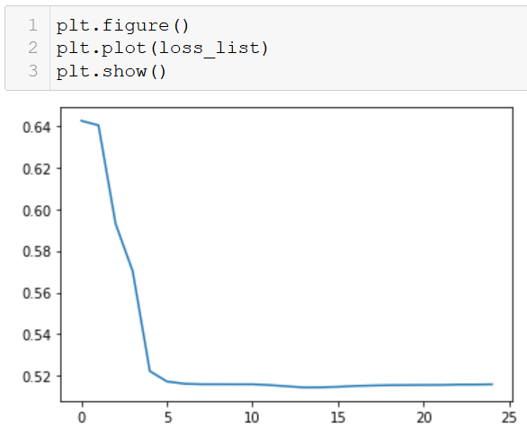
A first toy example: MNIST autoencoder with fully connected layers

Slide 27
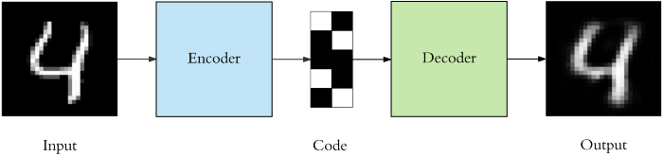
A first toy example: MNIST autoencoder with fully connected layers

Slide 28
AutoEncoders structure (Reminder)
Bottleneck: which is the layer that contains the compressed representation of the input data. Technically, we want the dimensionality to be the lowest possible dimension of the input data. How to decide on the best dimensionality for the hidden_size?

Slide 29
On latent dimensionality
How to decide on the best dimensionality for the hidden_size?
Technically, we want the dimensionality to be the lowest possible dimension of the input data.
It is often impossible to define it mathematically.
More of a trial and error process, with a tradeoff at play.
Higher size More accurate representation, more parameters to train.
Lower size Less accurate representation, less parameters to train

Slide 30
On latent dimensionality
In Notebook 1, we have trained 4 models with different hidden layer sizes for comparison purposes.
Model #1: hidden_size = 5
Model #2: hidden_size = 25
Model #3: hidden_size = 125
Model #4: hidden_size = 784 = 28*28
We then visualize the performance of each model, in terms of loss and in terms of outputs visualization.

Slide 31
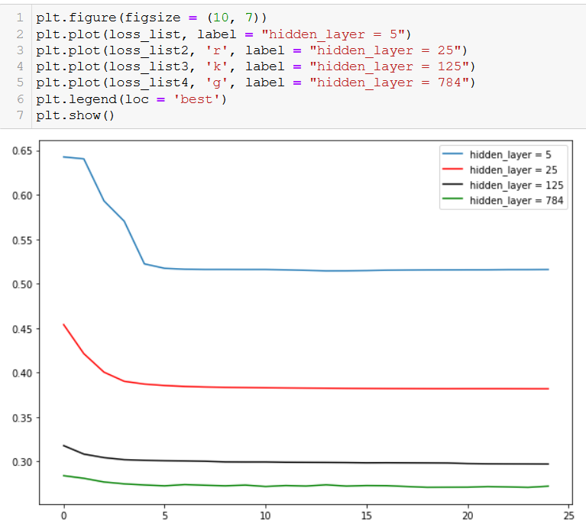
On latent dimensionality vs. loss effect

Slide 32
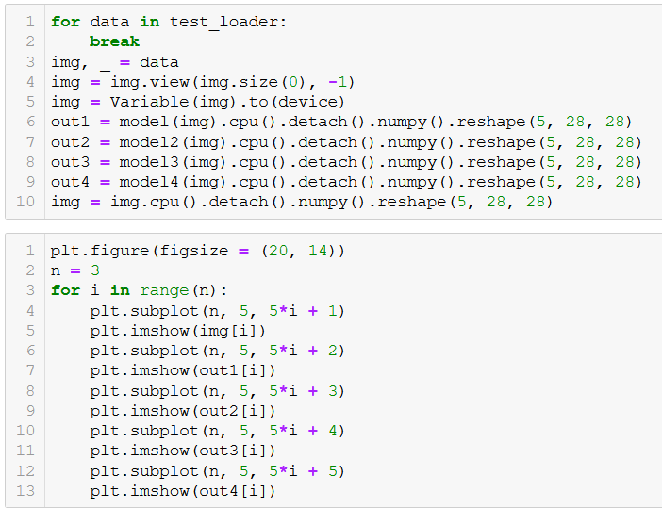
On latent dimensionality vs. reconstruction quality

Slide 33
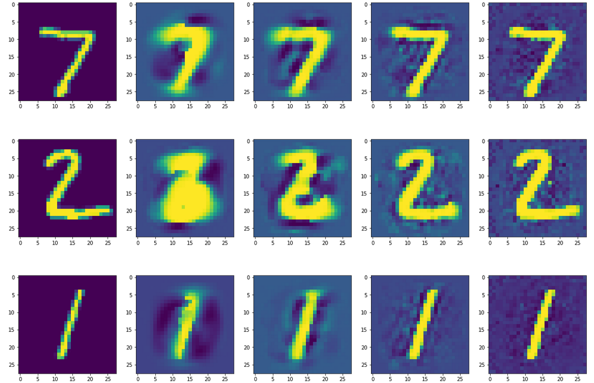
On latent dimensionality vs. reconstruction quality
Original image Model1 Model2 Model3 Model4

Slide 34
A first toy example: MNIST autoencoder with fully connected layers (Reminder)
Let us start with a simple autoencoder on MNIST (refer to Notebook 1. for demo code). Our model consists of
An encoder, simply modelled as a fully connected layer from 28*28 into a hidden layer size, to be decided.
A decoder, simply modelled as a fully connected layer from the hidden layer size, back into 28*28.
The two FC layers were performing “inverse” operations, in terms of dimensionality.

Slide 35
A first toy example: MNIST autoencoder with fully connected layers (Reminder)
Let us start with a simple autoencoder on MNIST (refer to Notebook 1. for demo code). Our model consists of
An encoder, simply modelled as a fully connected layer from 28*28 into a hidden layer size, to be decided.
A decoder, simply modelled as a fully connected layer from the hidden layer size, back into 28*28.
The two FC layers were performing “inverse” operations, in terms of dimensionality.
However, we never use FC layers on images, but CNNs instead.
→ What would then be the “inverse” operation of the convolution?

Slide 36
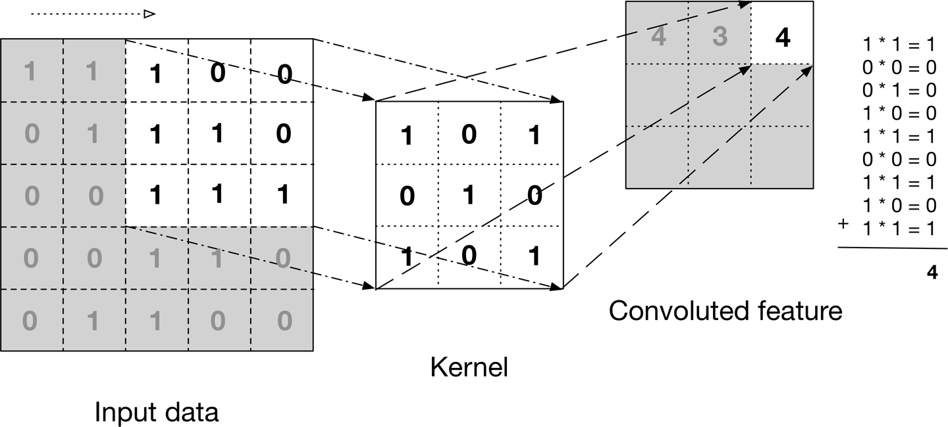
Convolution layers (reminder)
Convolution layers performed transformations of input and output by convolutions.
Magic formula:
output_size = (input_size + 2*padding – kernel_size + stride)/stride
Holds per dimension, i.e. 1D, 2D and N-D convolutions.

Slide 37
Convolution layers (reminder)
Convolution layers performed transformations of input and output by convolutions.
Convolutions were typically used in CNNs to progressively reduce the size of the input images into a fully-connected layer with expected dimension.
What would then be the “inverse” operation of convolution layers?

Slide 38
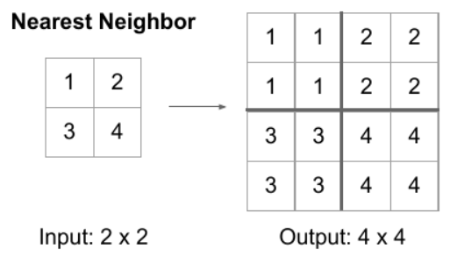
Option 1: Nearest Neighbors upsampling
Definition (Nearest Neighbors upsampling technique)
In the Nearest Neighbors upsampling technique, we simply take an input pixel value and copy it to the K-Nearest Neighbors where K depends on the expected output.

Slide 39
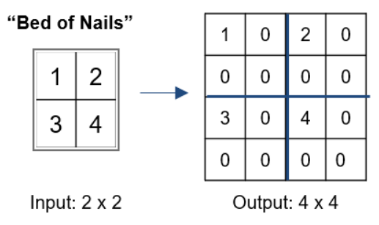
Option 2: Bed of Nails upsampling
Definition (Bed of Nails upsampling technique)
In the Bed of Nails upsampling technique, we simply take the value of the input pixel at the corresponding position in the output image and filling zeros in the remaining positions.

Slide 40
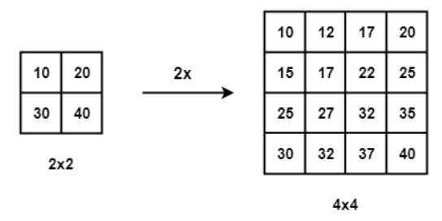
Option 3: Bi-Linear Interpolation upsampling
Definition (Bi-Linear Interpolation upsampling technique)
In the Bi-Linear Interpolation upsampling technique, we take the 4 nearest pixel value of the input pixel and perform a weighted average based on the distance of the four nearest cells, therefore smoothing the output.

Slide 41
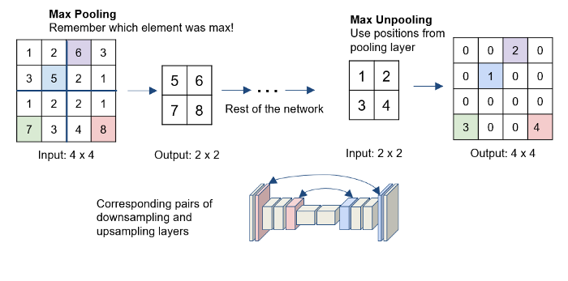
Option 4: Reversed MaxPooling upsampling
Definition (Reversed MaxPooling upsampling technique)
The Max-Pooling layer in CNN takes the maximum among all the values in the kernel.
To perform Reversed MaxPooling , first, the index of the maximum value is saved for every max-pooling layer during the encoding step.
The saved index is then used during the decoding step where the input pixel is mapped to the saved index, filling zeros everywhere else.

Slide 42
On the need for deconvolution layers
Problem #1: the four options mentioned earlier are a bit too simplistic and might not be able to “reconstruct” the missing information of an image properly.
Problem #2: more importantly, these layers are not trainable and we have no control over them.

Slide 43
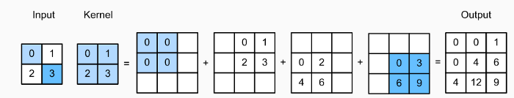
Deconvolution operation
Definition (Deconvolution layer):
The Deconvolution (also commonly referred to as Transposed Convolution, or Fractionally Strided Convolution) layer is used to upsample the input feature map to a desired output feature map using some learnable parameters.
Works as a convolution, multiply input with kernel elements but copy output in multiple locations to upsample.

Slide 44
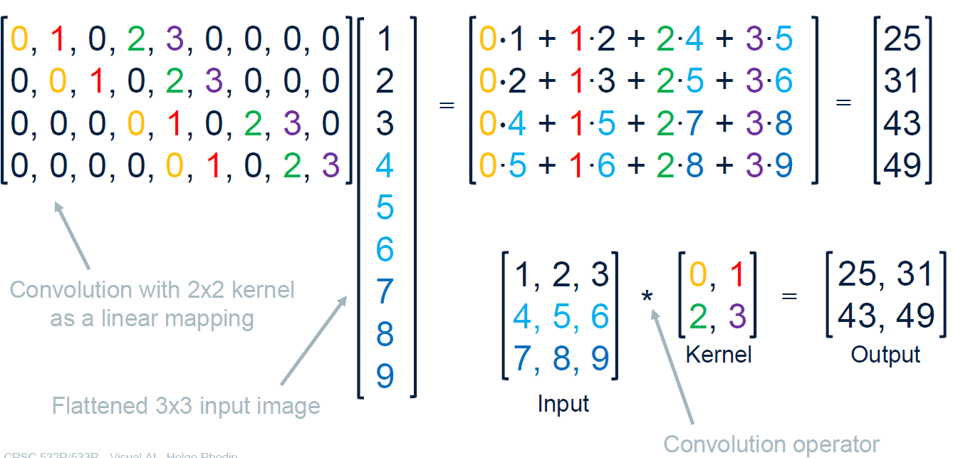
Deconvolution operation
The Deconvolution layer consists of a simple matrix multiplication.

Slide 45
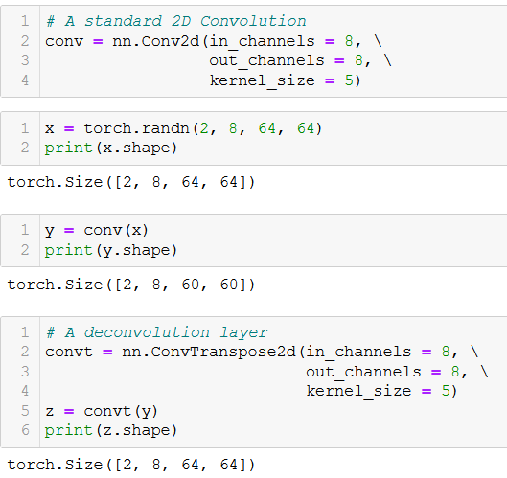
Deconvolution operation
Deconvolution layers are trainable layers, which allow to upsample an input (as opposed to downsampling Convolution layers).
They are easily implemented on PyTorch, using the ConvTranspose types of layers (exists in 1D, 2D, and n-D if needed).

Slide 46
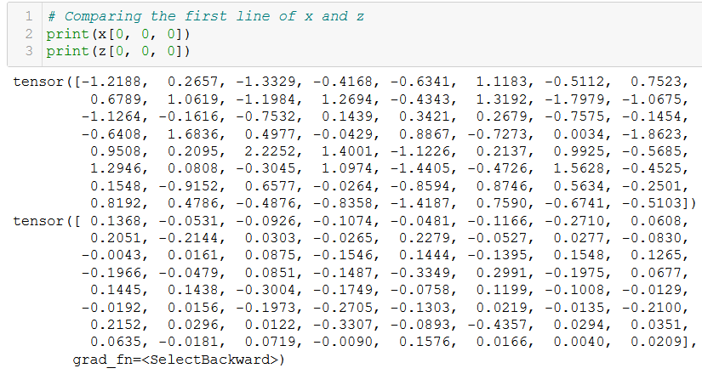
Deconvolution operation
Deconvolution layers are trainable layers, which allow to upsample an input (as opposed to downsampling Convolution layers).
Important note: Deconvolution is NOT the inverse operation of Convolution, mathematically speaking!

Slide 47
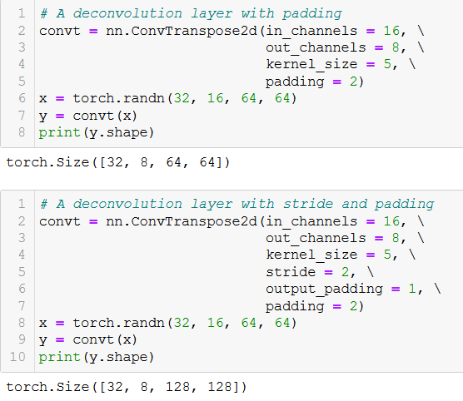
Deconvolution operation
Deconvolution also works with additional parameters, such as stride and padding.
They might also take an additional parameter, known as output padding: while standard padding is applied to the input elements, output padding is simply an additional size added to one side of each dimension in the output shape.

Slide 48
Convolution layers (reminder)
Convolution layers performed transformations of input and output by convolutions.
Magic formula:
output_size = (input_size + 2*padding – kernel_size + stride)/stride
Holds per dimension, i.e. 1D, 2D and N-D convolutions.

Slide 49
Convolution vs. Deconvolution layers
Convolution layers performed transformations of input and output by convolutions.
Magic formula:
output_size = (input_size + 2*padding – kernel_size + stride)/stride
Holds per dimension, i.e. 1D, 2D and N-D convolutions.
Deconvolution layers performed transformations of input and output by upsampling convolutions.
Magic formula:
output_size = (input_size – 1)*stride - 2*padding + kernel_size + output_padding
Holds per dimension, i.e. 1D, 2D and N-D convolutions.

Slide 50
A note on dilation in Deconvolution layers
Deconvolution layers can also take one additional parameter called dilation (it has some very niche uses, which are out-of-class).
This slightly changes the magic formula into:
output_size = (input_size – 1)*stride - 2*padding + output_padding + 1 + dilation*(kernel_size − 1)
Holds per dimension, i.e. 1D, 2D and N-D convolutions.
Note: dilation is hard to explain but easily visualized. (https://github.com/vdumoulin/conv_arithmetic/blob/master/README.md)

Slide 51
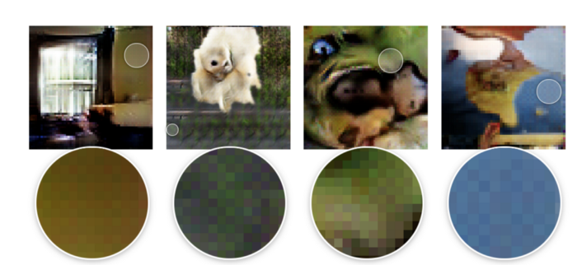
A note on Deconvolution layers
Transposed convolutions are not perfect, as they suffer from “chequered” board effects.
The main cause of this is uneven overlap at some parts of the image causing artifacts.
This can be fixed, or at least partially reduced, by using a kernel size divisible by the stride, e.g taking a kernel-size of 2x2 or 4x4 when having a stride of 2.

Slide 52
AutoEncoder with Conv and DeConv layers
Let us put our Deconvolution layers to use, by replacing the FC layers in our original autoencoder, with Convolutions and Deconvolution ones!

Slide 53

AutoEncoder with Conv and DeConv layers

Slide 54
AutoEncoder with Conv and DeConv layers
Let us put our Deconvolution layers to use, by replacing the FC layers in our original autoencoder, with Convolutions and Deconvolution ones!
Deconvolutions in the decoder phase follow the same logic (dimensionality variations) as the convolutions ones in the encoder phase.

Slide 55
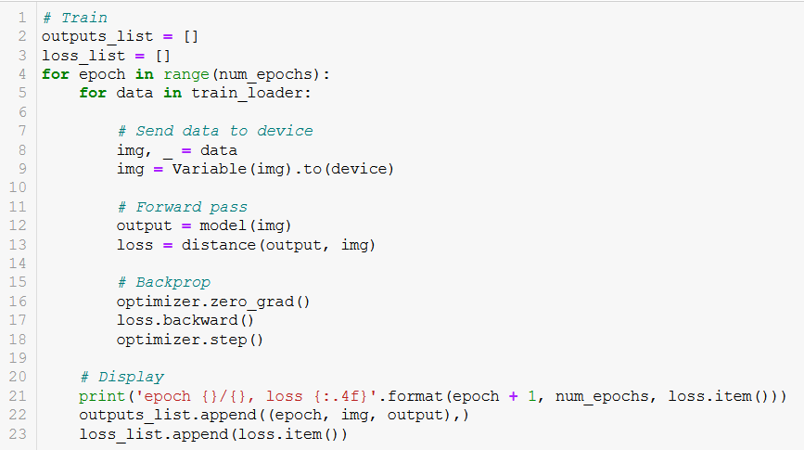
AutoEncoder with Conv and DeConv layers
Our trainer function does not change, except for the part where we were flattening the input image (no longer necessary, convolutions).

Slide 56
AutoEncoder with Conv and DeConv layers
Our trainer function does not change, except for the part where we were flattening the input image (no longer necessary, convolutions).

Slide 57
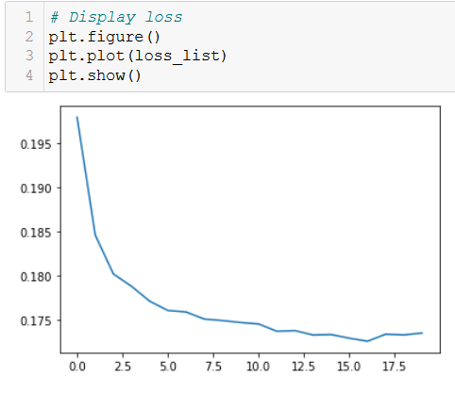
AutoEncoder with Conv and DeConv layers

Slide 58
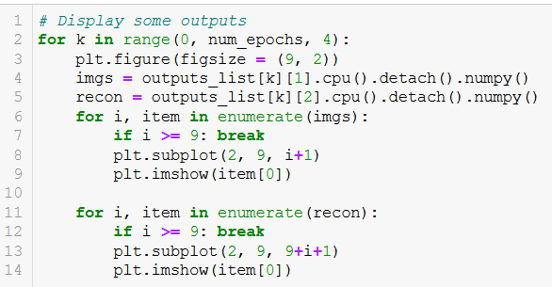
AutoEncoder with Conv and DeConv layers
We can also see the evolution on the outputs being generated during the different iterations of training.

Slide 59
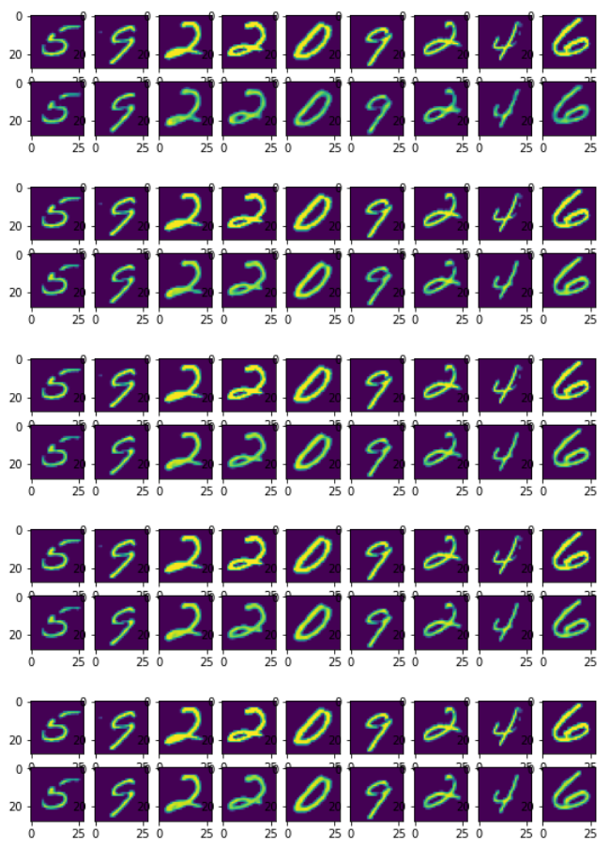
Iteration 5
Iteration 10
Iteration 15
Iteration 20
Iteration 25

Slide 60
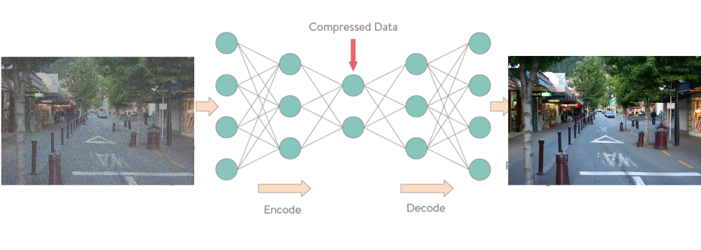
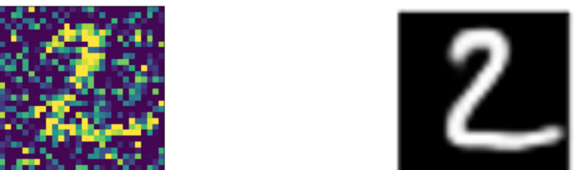
AutoEncoders for Signal Denoising
On top of their ability to encode an input into a low-dimension latent vectors, the AutoEncoders can be used for…
Denoising images: the autoencoder will simply focus on keeping the most important features of the image and will likely drop the noise present in the image.
This can be used to protect against Noising Attacks!

Slide 61
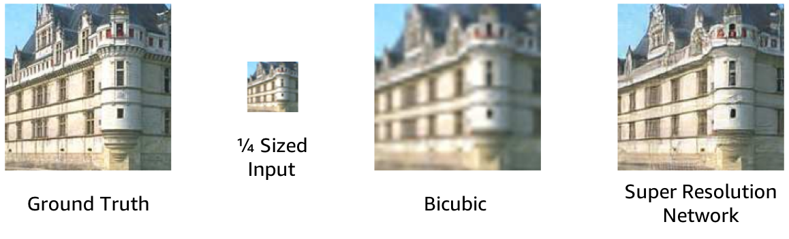
AutoEncoders for Supersizing Images
On top of their ability to encode an input into a low-dimension latent vectors, the AutoEncoders can be used for…
Supersizing images: the autoencoder will simply attempt to reconstruct the missing pixels in the image to increase its resolution.
Ground Truth
Downsample, and then pixelate with Nearest Neighbors
Output (super resolution)

Slide 62
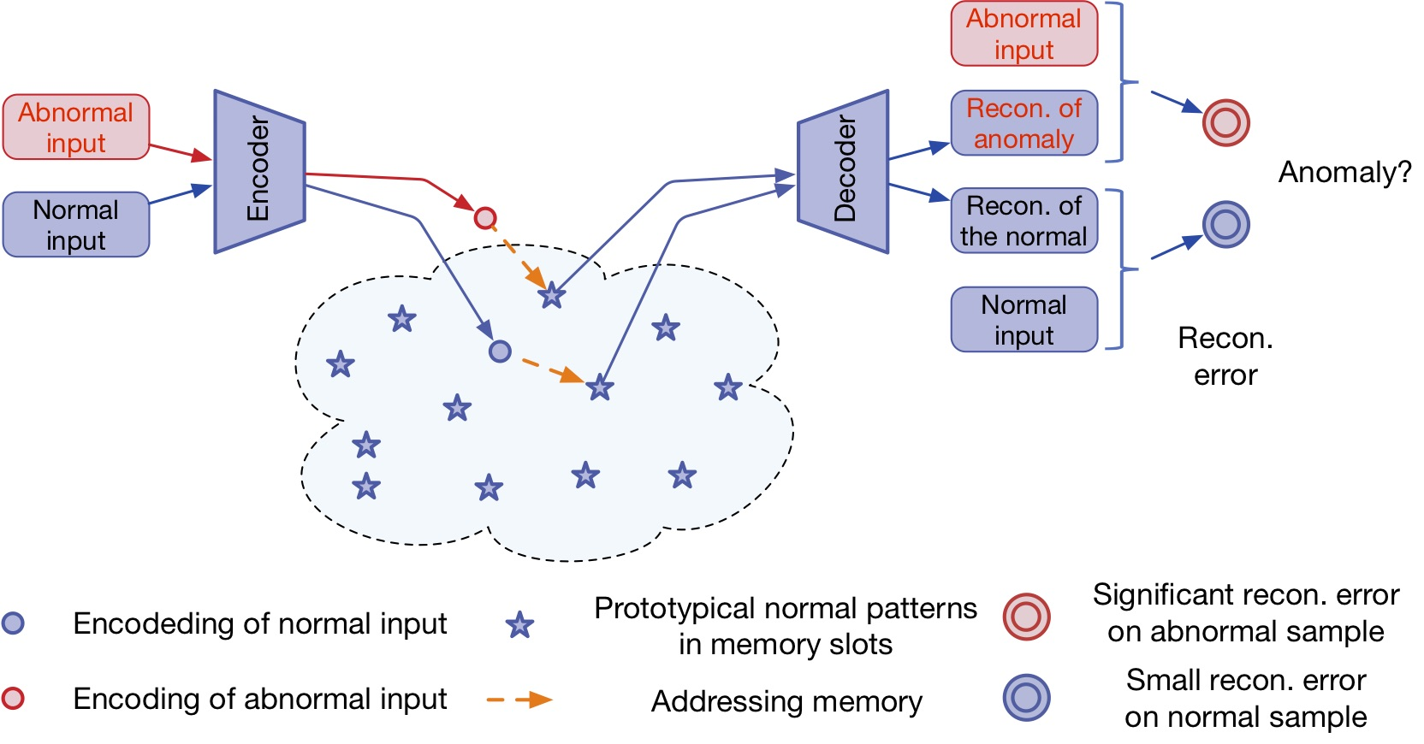
AutoEncoders for Anomaly Detection
On top of their ability to encode an input into a low-dimension latent vectors, the AutoEncoders can be used for…
Anomaly detection: There are many ways and techniques to detect anomalies and outliers. However, if you have correlated input data, the autoencoder method will work very well because the encoding operation relies on the correlated features to compress the data.

Slide 63
Conclusion
In this lecture
Autoencoders definition
Autoencoders with fully connected layers
Fractionally strided convolution layers
Autoencoders with convolutions and deconvolutions
Autoencoder uses
In the next lectures
Variational Autoencoder and noisy latent representations
Generative Adversarial Networks
More advanced GANs

Slide 64
Learn more about these topics
Out of class, for those of you who are curious
None for now!

